Slide 1

Time Series Analysis & Forecasting of UK Air Quality
Solving Environmental Problems with R & Shiny
Nathaniel Bassett & Malachi Chambers

Slide 2
Contents
•
1. Problem Identification
•
5. Shiny App Architecture
•
2.The Dataset (DEFRA AURN)
•
6. Results & Visualization
•
3. Package Choice: forecast
•
7. Accuracy & Validation
•
4. Technical Implementation
•
8. Conclusion

Slide 3


The Scientific Problem
Time Series Forecasting
Air quality is complex, non-linear, and influenced by seasonal weather patterns and traffic.
Policymakers need evidence based tools to forecast pollution levels to protect public health.
Air quality is shaped by a complex interplay of unpredictable traffic patterns and changing weather, making it a challenge for standard linear models to capture
Temporal Dependancy
Nested seasonality
Observed pollutant levels are statistically linked to their own past values. Standard regression assumes data independence, whereas time-series modelling must account for this “memory” to provide accurate future estimates
Pollutants exhibit overlapping cycles: daily rush-hour spikes, weekly traffic rhythms, and winter temperature inversions. Disentangling these patterns from long-term trends is critical for identifying true environmental shifts.

Slide 4
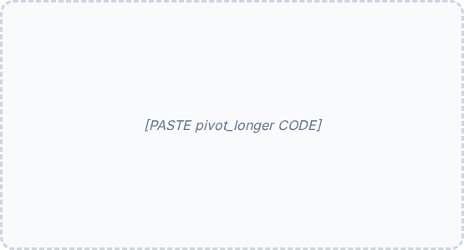
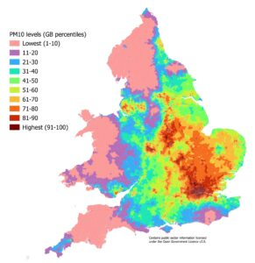
Why Forecast Air Quality
Understanding the value of predictive air-quality monitoring
Forecasting allows high pollution periods to be identified before harmful conditions occur.
Early warnings help reduce exposure risks for vulnerable populations, including children, elderly individuals, and people with respiratory conditions.
Forecasting supports evidence-based policymaking, traffic regulation, and environmental planning.
Authorities can respond more effectively by preparing mitigation strategies during predicted pollution spikes.

Slide 5
Project Overview and Objectives
Project Overview
This project delivers an interactive, web-based dashboard designed to explore and forecast UK air quality and pollutant patterns. By utilizing historical monitoring data (2020–present), the application provides a user-friendly interface for visualizing environmental trends and applying advanced time-series forecasting.
.
Key Objectives
Trend Visualization: To provide an intuitive platform for exploring how air quality and weather variables change over different temporal scales (Daily, Weekly, Monthly, Yearly).
Model Comparison: To implement and test multiple time-series forecasting engines including ARIMA, ETS, and Naive methods. Also to identify the most reliable predictors for specific monitoring sites.
Performance Evaluation: To facilitate data-driven decision making by quantifying model performance using scientific accuracy metrics like RMSE, MAE, and MAPE.
Accessible Analytics: To lower the barrier to entry for environmental analysis, allowing users to interact with complex statistical models without needing direct access to the underlying code.

Slide 6
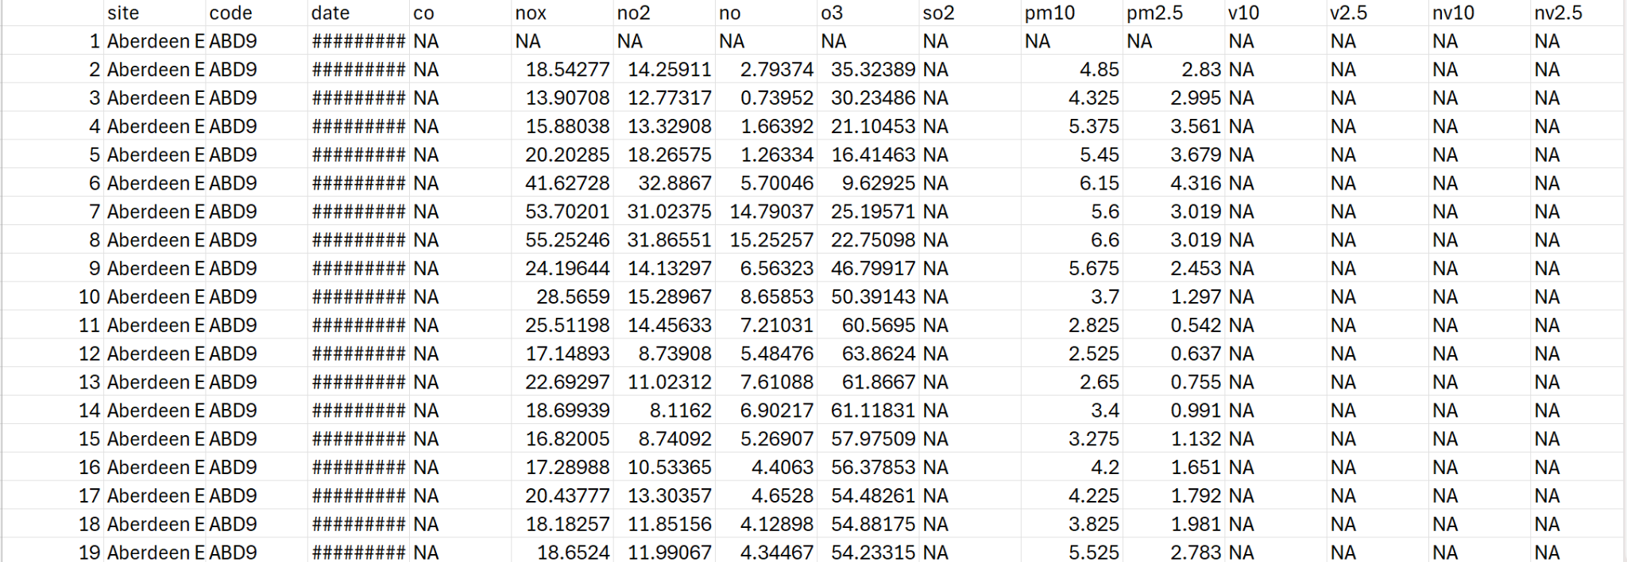
The Dataset: AURN
We used the Automatic Urban and Rural Network (AURN) dataset.
•
Hourly observations from 2015-2023.
•
Variables: NO2, PM10, PM2.5, Ozone, and Weather data.
•
Challenge: Large file size with over 1,000,000 rows and a lot missing values (NAs).

Slide 7


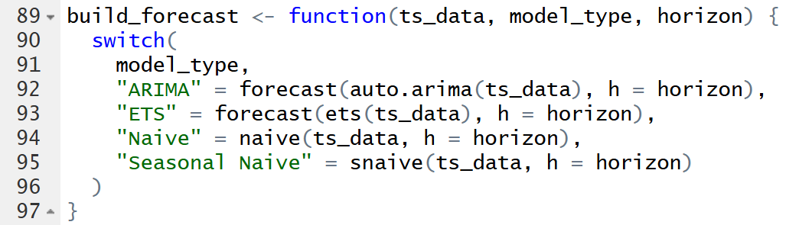
Package Choice: forecast
•
Beyond the standard library, we utilized the forecastpackage by Rob Hyndman.
The forecast package provides a comprehensive suite of forecasting methods. Our analysis focuses on two of its most powerful advanced engines: ARIMA and ETS.
•
ARIMA (Auto-Regressive Integrated Moving Average)
ETS (Exponential Smoothing)
Automatically discovers the optimal (p, d, q) parameters for a non-stationary time series. It looks at how past values and past forecast errors influence the future, while using "differencing" to stabilize data that has a trend.
Decomposes the time series into three clear components: the underlying Trend (the long-term direction), the Seasonality (the repeating cycle), and the Error (the noise).

Slide 8
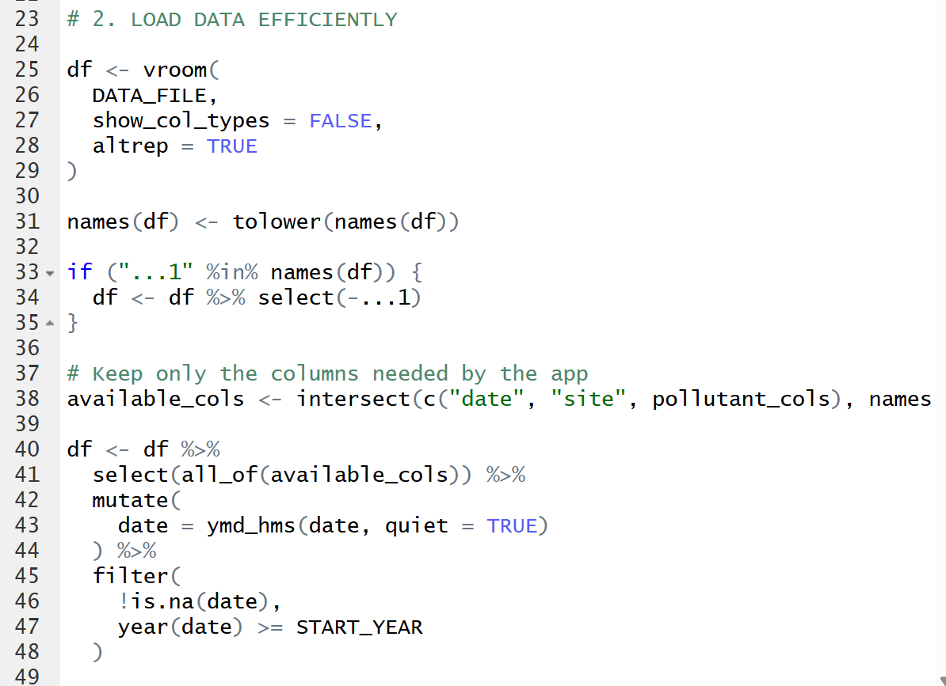
Technical Methodology
Efficiency & Cleaning
To ensure the app remains ready and responsive:
•
Used vroom for fast indexed reading.
•
Filtered data to 2020+ to focus on recent trends.
•
Handled missing values using !is.na().

Slide 9
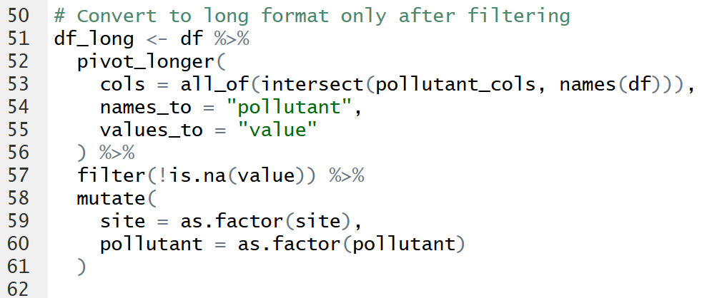
Tidy Data Transformation
Long Format Conversion
To visualize multiple pollutants in Shiny, we transformed the data from "Wide" to "Long" using pivot_longer().

Slide 10
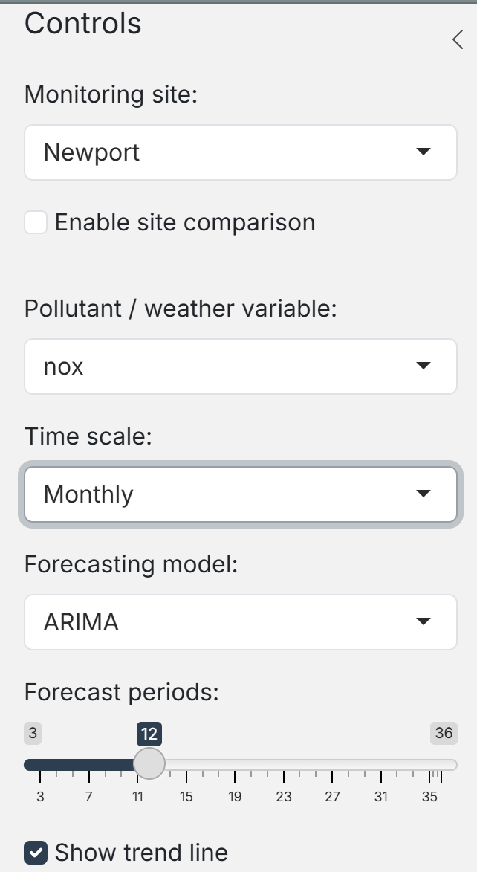

Shiny App Architecture
Dashboard User Interface (UI) Design
•
Design Framework: Built using bslib with the flatly theme for a modern, clean, and intuitive aesthetic.
Sidebar Controls: Centralized input controls (selectInput, sliderInput) allow users to manipulate data filters and forecasting parameters in real-time.
Metrics: value_box components provide instant visual feedback on the selected site, variable, and active model.
Tabbed Navigation: Used navset_card_tab to compartmentalize functionality, separating Exploratory Data Analysis from Forecasting and Model Accuracy.
•
•
•

Slide 11
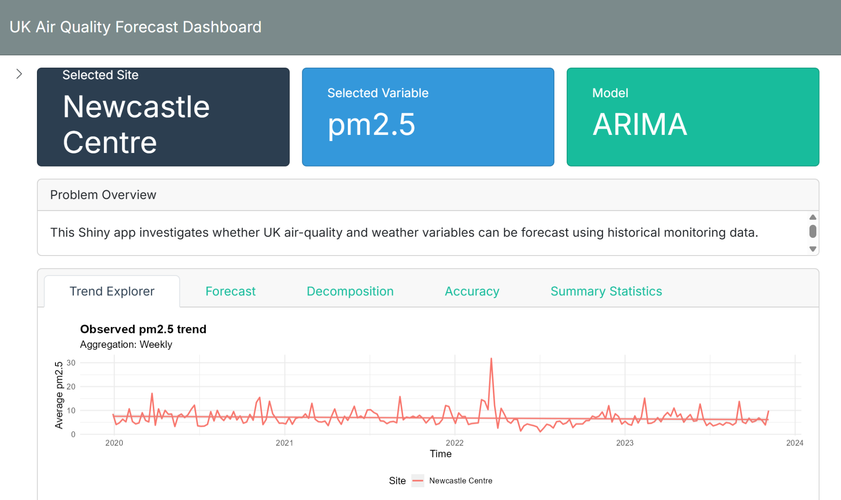
Shiny App Architecture

Slide 12
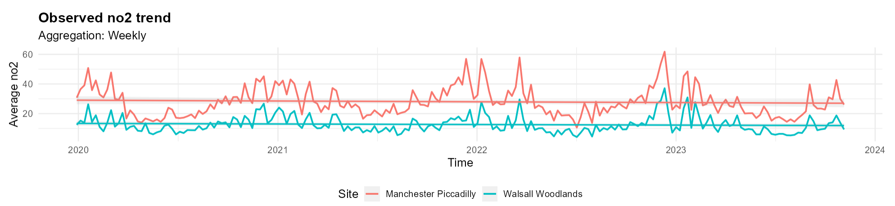
Results: Observed Trends
Site Comparison
Our app allows you to visualise and compare trends from two different sites
Here you can see the NO2 trend from and urban area (Manchester Piccadilly) and a rural area (Walsall Woodlands)
You can also see how NO2 levels spike in the winter and tend to be at their lowest in summer

Slide 13
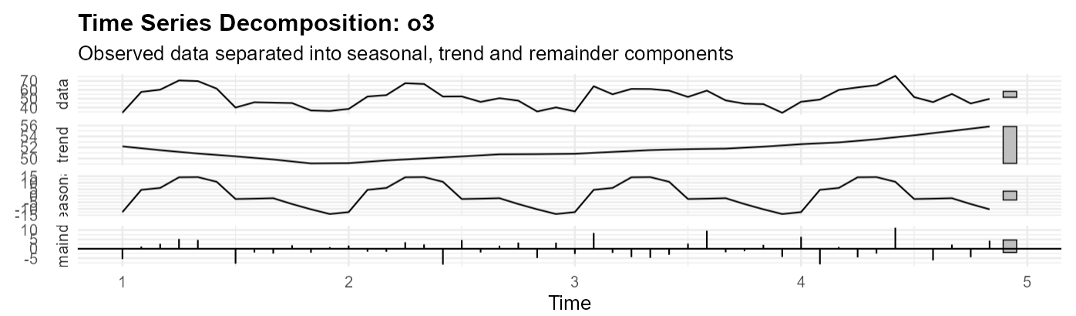
Results: Decomposition
Isolating Seasonality
Using stl(), we separate the data into:
•
Trend: The overall direction.
•
Seasonal: The repeating cycle.
•
Remainder: Random noise.

Slide 14
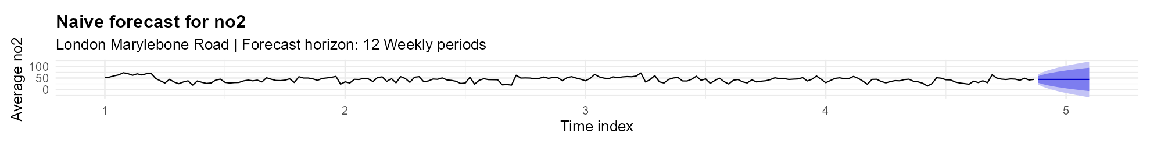
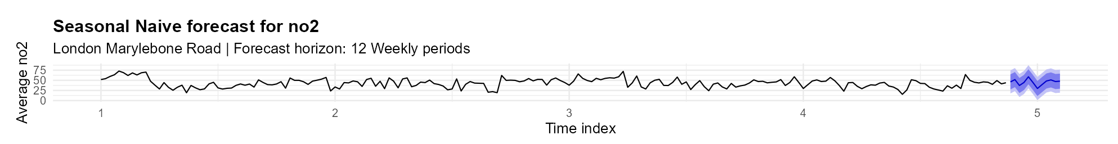
Predictive Analysis: Baseline Models
Naive
•
Predicts today is the same as yesterday
Seasonal naive
•
Predicts today is the same as the same time last year
Tb

Slide 15
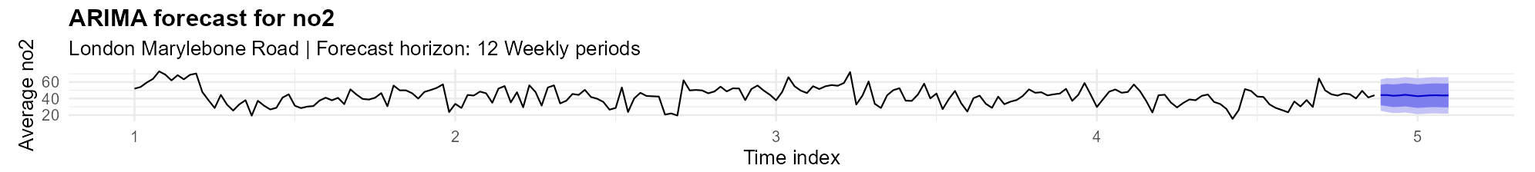
Predictive Analysis: Advanced modelling
ARIMA Forecasting
•
Analyses the “memory” of the dataset
Uses differencing to stabalise non-stationary trends
Excels at capturing complex, non-linear dependencies
•
•

Slide 16
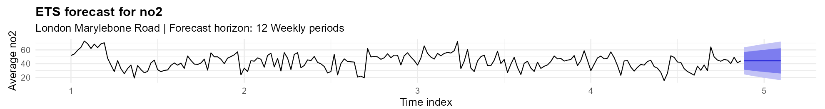
Predictive Analysis: Advanced modelling
ETS Forecasting
•
Focuses on the structural decomposition of the time series
Explicitly models repeating cycles
Ideal for with strict seasonal rhythms
Provides intuitive state-space forecasting
•
•
•

Slide 17

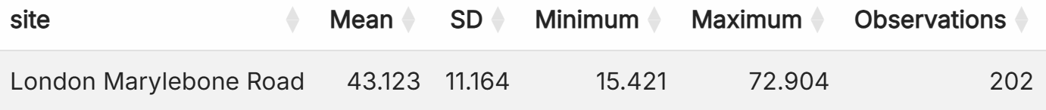
Model Performance Comparison (Test Set)
Summary of statistics (NO2)
We used an 80/20 Train-Test split.
Metrics like MAPE (Mean Absolute Percentage Error) allow us to compare model performance across different pollutants.
Lower RMSE, MAE and MAPE values indicate better forecasting performance.
Model Name | RMSE | MAE | MAPE (%)
Naive | 12.562 | 9.904 | 33.204
Seasonal Naive | 13.512 | 10.346 | 31.003
ARIMA (Top Performance) | 10.925 | 8.345 | 27.81
ETS | 12.01 | 9.347 | 31.375

Slide 18
Validating Robustness: Train vs. Test
Train vs. Test (NO2)
•
We compare performance on the Training Set (known data) vs. the Test Set (unseen data) to identify overfitting.
Dataset | RMSE | MAE | MAPE (%)
Training Set | 10.194 | 8.097 | 21.123
Test Set | 10.925 | 8.345 | 27.81
•
The consistent performance across both sets with Test error (RMSE: 10.9) slightly outperforming Training error (RMSE: 11.6) confirms that the model successfully captured the scope of the data without being misled by localized noise or outliers in the training phase.
Training error was slightly lower than Test error. This is the standard outcome, indicating the model learned the training patterns effectively, with a slight, expected loss of accuracy on unseen data
•
The metrics show a consistent and narrow gap, confirming that the ARIMA model has high generalization capacity for London Marylebone Road.

Slide 19
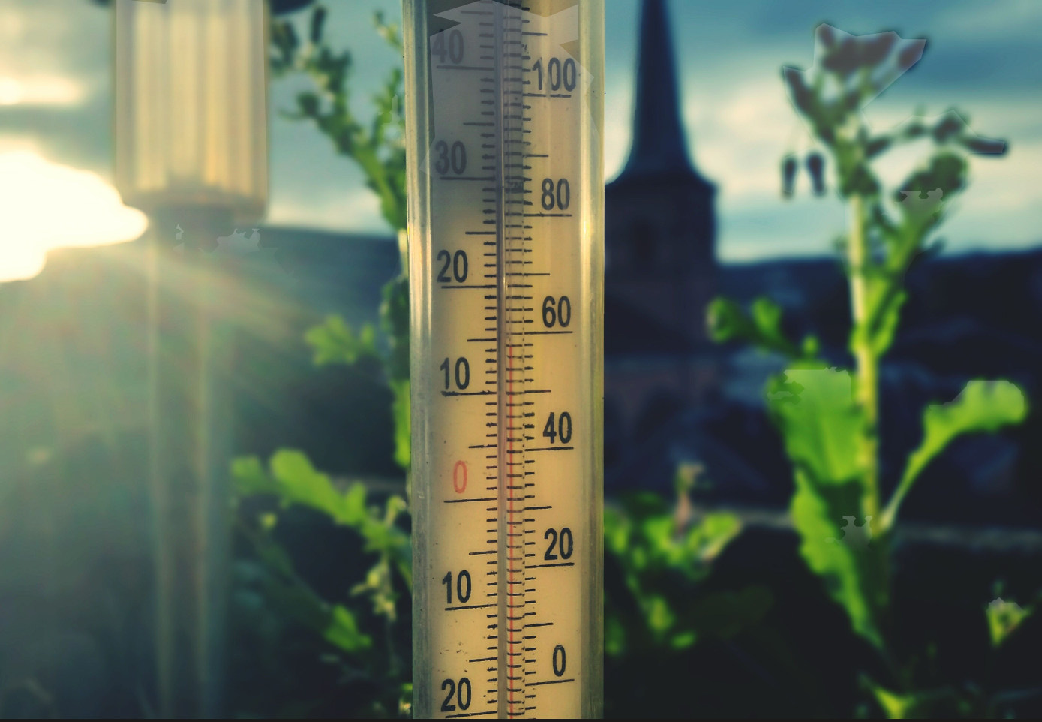
Validating Robustness: Train vs. Test
Train vs. Test (Air Temperature)
Dataset | RMSE | MAE | MAPE (%)
Training Set | 2.257 | 1.366 | 132.537
Test Set | 1.893 | 1.497 | 16.829
The Test set outperformed the Training set. This suggests that the test period was characterized by more stable, consistent weather patterns compared to the higher volatility observed in the training period.
Robustness Conclusion: The narrow variance between Training and Test metrics across both pollutants confirms that our models have not overfitted to the training data. The model remains stable and reliable when applied to new, unseen time periods.

Slide 20

Conclusion
Our Shiny app successfully transforms raw air quality data into a teaching tool for time-series forecasting.
•
Implemented advanced forecasting via forecast package.
•
Optimized data pipeline for real-time interactivity.
•
Validated results through scientific error metrics.

